Slide 1
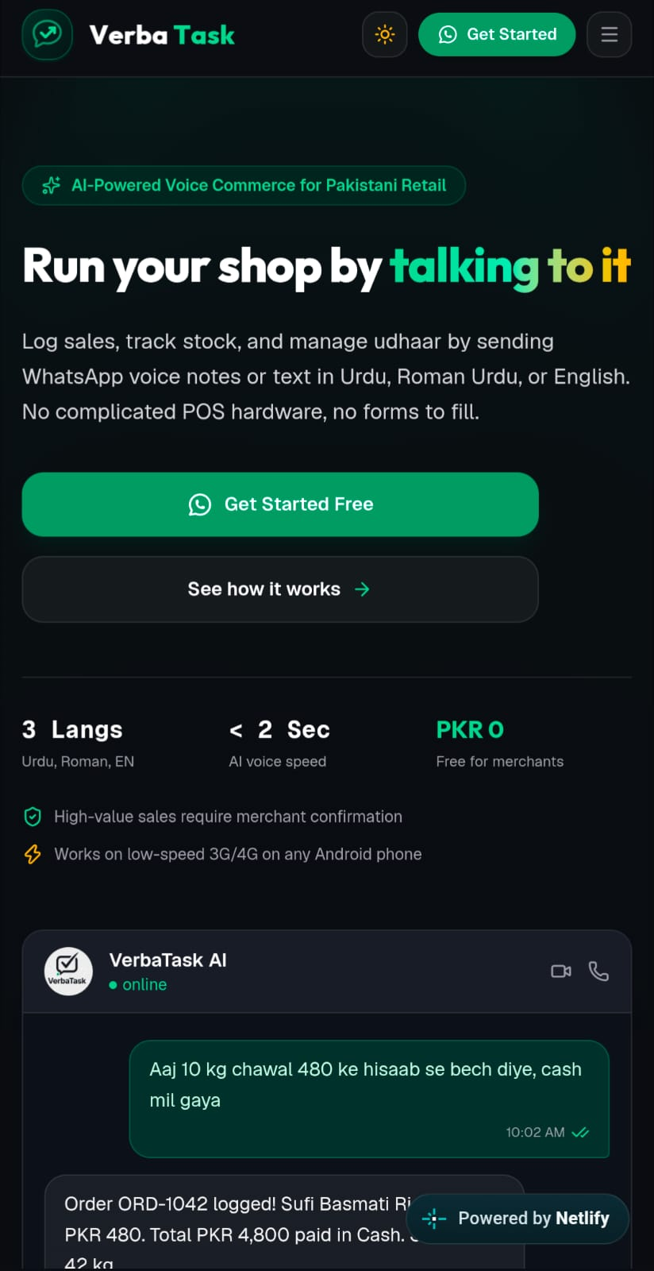
VerbaTask
Run Your Shop by Talking
The Voice-First Commerce OS on WhatsApp — eliminating software friction for 2M+ micro-retailers without apps, English literacy, or expensive hardware.
Contact
verbatask.business@gmail.com

Slide 2
THE BUILDERS
The Team Behind VerbaTask
Built from scratch for Pakistan's retail reality.
Muhammad Soban
Muhammad Ali
Our Mission
Backend & AI Engineer
Backend & AI Engineer
Bridging cutting-edge artificial intelligence with the everyday reality of neighborhood retail. We don't build software that forces shopkeepers to change; we build intelligence that meets them where they already are.
Talal Nasir
Muhammad Shiraz
Frontend & UI/UX Engineer
Frontend & UI/UX Engineer
Our Philosophy
Zero friction, zero barrier to entry. If technology cannot be used by a traditional dukaandar on a busy Friday afternoon, it isn't ready for emerging markets. We are digitizing retail one voice note at a time.

Slide 3

TECHNOLOGY FOUNDATION
Powered by Alibaba Cloud & Qwen AI
Intelligence built on the Qwen ecosystem — the only LLM stack that natively understands how Pakistani shopkeepers actually speak.
Core Partnership
Multilingual Dominance
Driven by Alibaba Cloud's high-performance Qwen 2.5 large language models — enterprise-grade intelligence at micro-retailer scale.
Qwen natively deciphers colloquial Pakistani Urdu, Roman Urdu idioms, and bazaar slang where every generic model stumbles and fails.
Enterprise Reliability
Sub-second JSON entity extraction and cloud scalability engineered for millions of high-frequency micro-transactions daily.

Slide 4



THE PROBLEM — GROUND REALITY
A Day in the Life of Tariq Bhai
Tariq Bhai runs a busy neighborhood kiryana store handling 400+ transactions a day across grains, cooking oils, and daily essentials. Customers are shouting orders. Delivery trucks are dropping cartons. Cash is changing hands constantly.
400+ Daily Transactions
1
Grains, oils, essentials — all tracked by hand, all day long.
His entire business depends on a worn-out paper ledger — the "Khata" — prone to lost pages, math errors, and forgotten credit debts.
The Khata Problem
2
Lost pages, arithmetic errors, and forgotten credit debts are not bugs — they are features of the paper system.
This is not an edge case. This is the daily operating reality for over 2 million shopkeepers across Pakistan's urban and peri-urban markets.
Zero Digital Safety Net
3
No backup. No audit trail. No real-time visibility into what was sold, what is owed, or what is left in stock.

Slide 5




THE PROBLEM — WHY APPS FAIL
The 3 Fatal Friction Points of Traditional Retail Apps
Every major POS and inventory app has tried to crack this market. Every one has failed for the same three reasons.
🔤 Language & Literacy Trap
💸 The Hardware Tax
⏱ Rush Hour Barrier
Complex POS apps are built in formal English with deep menus that shop assistants simply cannot navigate.
Desktop terminals, barcode guns, and thermal printers cost over Rs. 80,000 — completely out of reach for small shops.
Nobody has time to unlock a tablet, search a catalogue, and type numbers while customers are waiting.
The Result: More than 85% of retail management apps get uninstalled within the first week of download.

Slide 6


THE EPIPHANY
Why Build an App When They Already Live on WhatsApp?
Shopkeepers spend 8 to 10 hours every day on WhatsApp communicating with suppliers, family, and customers. The platform is already open. The habit is already formed. The trust is already there.
50M+
Active WhatsApp Users
Zero Friction Onboarding
In Pakistan alone — the platform is already the de facto communication OS for the entire merchant class.
If a merchant knows how to hold down the green WhatsApp microphone, they already know how to operate VerbaTask. Full stop.
8–10h
No Storage Penalty
Daily Time on WhatsApp
Zero Play Store downloads. Zero phone storage consumed on entry-level Android devices that are already full.
Per shopkeeper — more time than any other app, tool, or platform in their daily workflow.

Slide 7
THE SOLUTION
Introducing VerbaTask — Your Voice-First Autonomous Back-Office
"2 mix mithai aur 5 kilo chawal cash pe bech diye."
That single spoken sentence — in colloquial Urdu, recorded as a WhatsApp voice note — is all it takes. VerbaTask handles everything else in under 2 seconds.
Merchant Speaks
AI Understands
A natural 3-second voice note in any mix of Urdu, Roman Urdu, or English. No formatting. No commands. Just talk.
Transcribes speech, identifies products across scripts, extracts quantities, rates, and payment method automatically.
System Executes
Dashboard Syncs
Deducts inventory, records revenue, and replies with a digital receipt and a voice note confirmation — all in 2 seconds.
Live web dashboard updates within 100ms via WebSockets. No refresh. No delay. Always current.

Slide 8


TECHNICAL ARCHITECTURE
Under The Hood — Sub-Second Voice AI Pipeline
Speak
Execute
Understand
High-Accuracy ASR
Zero-Shot Entity Parsing
Humanized Voice-Out
Full Stack
Groq-accelerated Whisper-large-v3 captures authentic Perso-Arabic Urdu script in approximately ~400ms.
Qwen 2.5 structures unpunctuated spoken sentences into strict, validated JSON commands — no training data required per merchant.
Edge Neural TTS (Uzma Neural) replies in natural spoken Urdu so merchants can listen to confirmations completely hands-free.
WhatsApp Cloud API → Whisper v3 → Qwen 2.5 → Edge TTS → MongoDB & WebSockets. Battle-tested. Production deployed.

Slide 9



LANGUAGE INTELLIGENCE
Breaking The Script Barrier — Cross-Lingual Phonetic Engine
The Challenge
The Solution
The inventory catalogue says "Mix Mithai" or "Rice". The merchant speaks "مکس مٹھائی" or types "chawal". Three different representations. One product. Generic NLP fails every time.
Custom bilingual dictionaries paired with phonetic Levenshtein matching bridge Urdu script, Roman Urdu, and English stock lists seamlessly — with no merchant training required.
Real-World Misspellings VerbaTask Handles
"sugr" → Sugar ✓
"cheni" → Sugar ✓
"oel" → Cooking Oil ✓
"chawal" → Rice ✓
85%
Match Confidence
Even on street misspellings and phonetic approximations of product names.
3x
Script Coverage
Urdu script, Roman Urdu, and English — all resolved to the same inventory item.
Illiteracy-forgiving by design — the system meets the merchant where they are, not where a textbook says they should be.

Slide 10
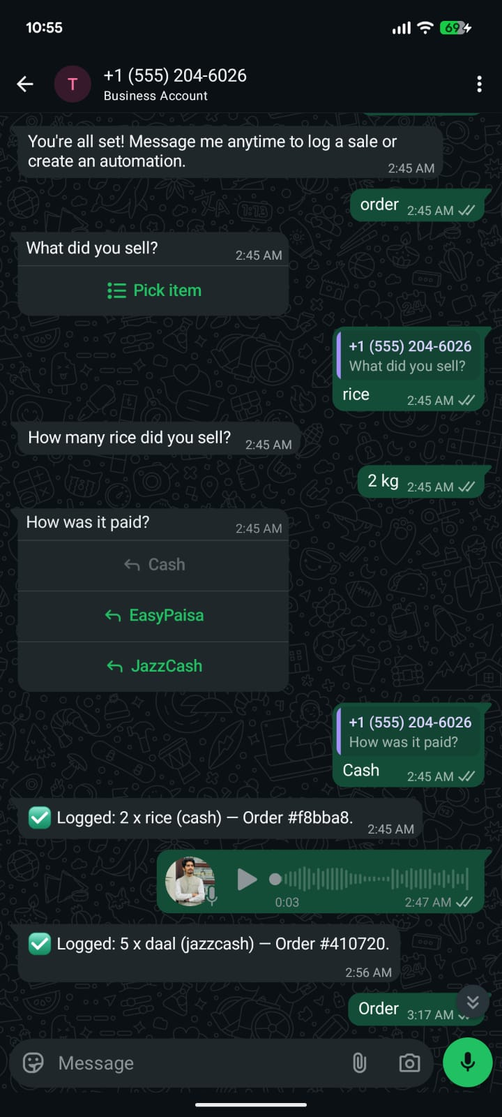
GUIDED FLOW & ZERO-TYPING CHECKOUT
Tapping Instead of Talking
Guided Order Menus
Merchants who prefer quiet environments can type "order" to trigger interactive, pageable WhatsApp stock lists.
Instant Payment Pickers
Interactive quick-action buttons for Cash, EasyPaisa, and JazzCash finalize sales in one tap.
Fault-Tolerant State
Atomic database updates guarantee that spotty 3G cellular connections never trap the merchant in broken loops.

Slide 11
STRATEGIC ROADMAP
What Comes Next
Phase 1
Phase 3
Live Today: WhatsApp voice sales logging, live inventory decrements, instant PDF audit reports, and cross-lingual NLP.
Q4 2026: Autonomous B2B replenishment—the AI automatically messages FMCG distributors when store inventory drops below minimum levels.
1
2
3
Phase 2
Q3 2026: Bluetooth portable thermal receipt printing directly from WhatsApp, plus phone camera carton barcode scanning.

Slide 12
BUSINESS MODEL & MONETIZATION
Pricing & Accessibility
100% Free Forever for Every Retailer.
PKR 0 / Month
Free Forever
Community Retail Tier — Zero Subscription. Zero Hidden Fees. Zero Barrier.
✦ Everything Included for Free:
Unlimited Voice Commerce: Speak naturally in colloquial Urdu, Roman Urdu, or English to record sales in under 2 seconds.
Autonomous Stock Tracking: Real-time inventory deduction with instant WhatsApp alerts before items run out of stock or expire.
Pakistani Payment Reconciliation: Track Cash, EasyPaisa, JazzCash, Raast, SadaPay, NayaPay, and bank transfers without manual math.
Instant WhatsApp PDF Audits: Download comprehensive, audit-ready daily sales ledgers and inventory summaries directly inside your chat.
Live Web Dashboard: Instant WebSocket synchronization with full desktop and mobile access in Obsidian Dark and Crisp Light modes.
✦ Why It Costs PKR 0:
Zero Cost to Dukaandars: Designed specifically for micro-retailers who cannot afford expensive software licenses.
Built on Scalable Free Rails: Leverages Meta's free WhatsApp conversation quota and lightweight, sub-second AI inference so the platform stays free, sustainable, and accessible to Main Street merchants.

Slide 13
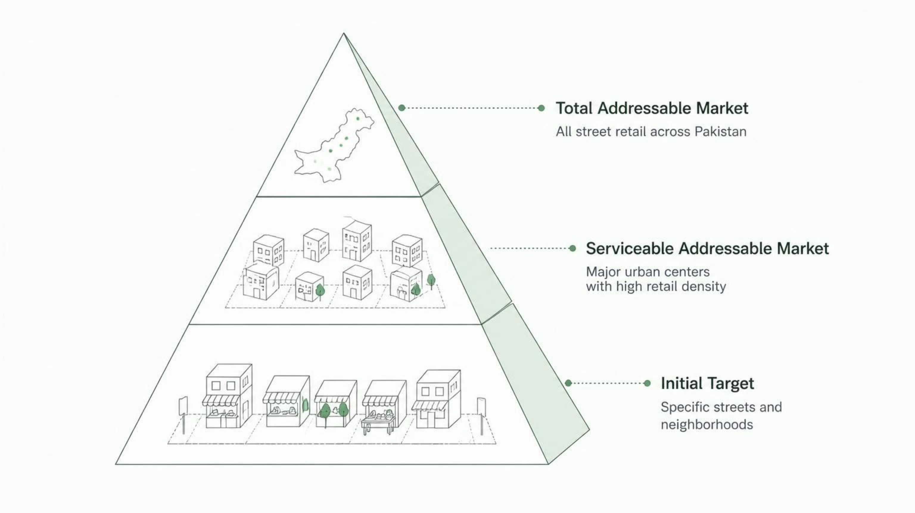
THE MARKET OPPORTUNITY
Digitizing 2.2 Million Retailers
Initial Target (SOM)
10,000 FMCG and neighborhood kiryana shops acquired through wholesale distributor partnerships and merchant referrals.
Serviceable Addressable Market (SAM)
850,000+ smartphone-owning dukaandars in Tier 1 and Tier 2 cities (Lahore, Karachi, Rawalpindi, Faisalabad, Multan).
Total Addressable Market (TAM)
2.2 Million small and micro retail stores across Pakistan.

Slide 14




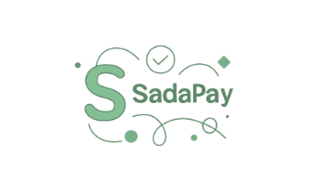
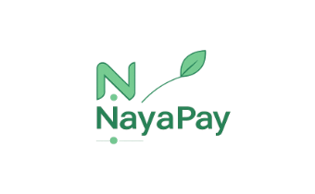


BUILT FOR PAKISTANI COMMERCE & BANKING
Native Integration with Local Financial Rails
VerbaTask is designed from the ground up to seamlessly integrate with Pakistan's unique commercial and banking ecosystem, ensuring full compatibility and easy reconciliation for merchants.
Complete Payment Spectrum
Automatic Alias Matching
End-of-Day Balancing
Native reconciliation for Cash, Mobile Wallets (EasyPaisa, JazzCash), EMIs (SadaPay, NayaPay, Raast), and Commercial/Islamic Banks (Meezan, HBL).
Resolves real payment terms like "sadapay pe aaya", "naqad mila", "meezan transfer", or "ایزی پیسہ".
Separates cash-in-drawer from digital receipts, eliminating cashflow mismatches.

Slide 15
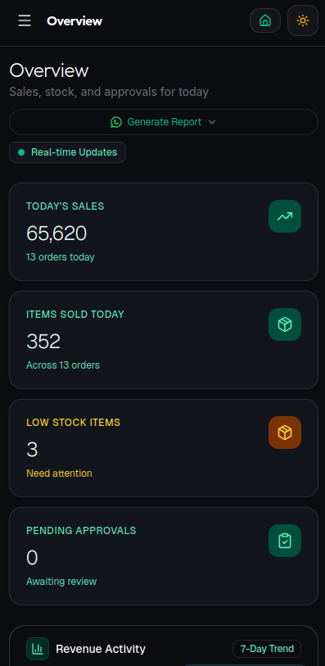
REAL-TIME WEB TELEMETRY
The Live Dashboard & Instant PDF Audits
Zero-Refresh WebSockets
Sales logged on WhatsApp appear on the live web dashboard in under 100 milliseconds.
On-Demand WhatsApp PDFs
Merchants type "report" or say "sales report bhejo" to receive audit-ready, formatted PDF ledgers directly in their chat.
Responsive Modern UI
Built with React 19, Tailwind CSS, and Obsidian Dark/Light modes for smooth operation on phones, tablets, or laptops.

Slide 16
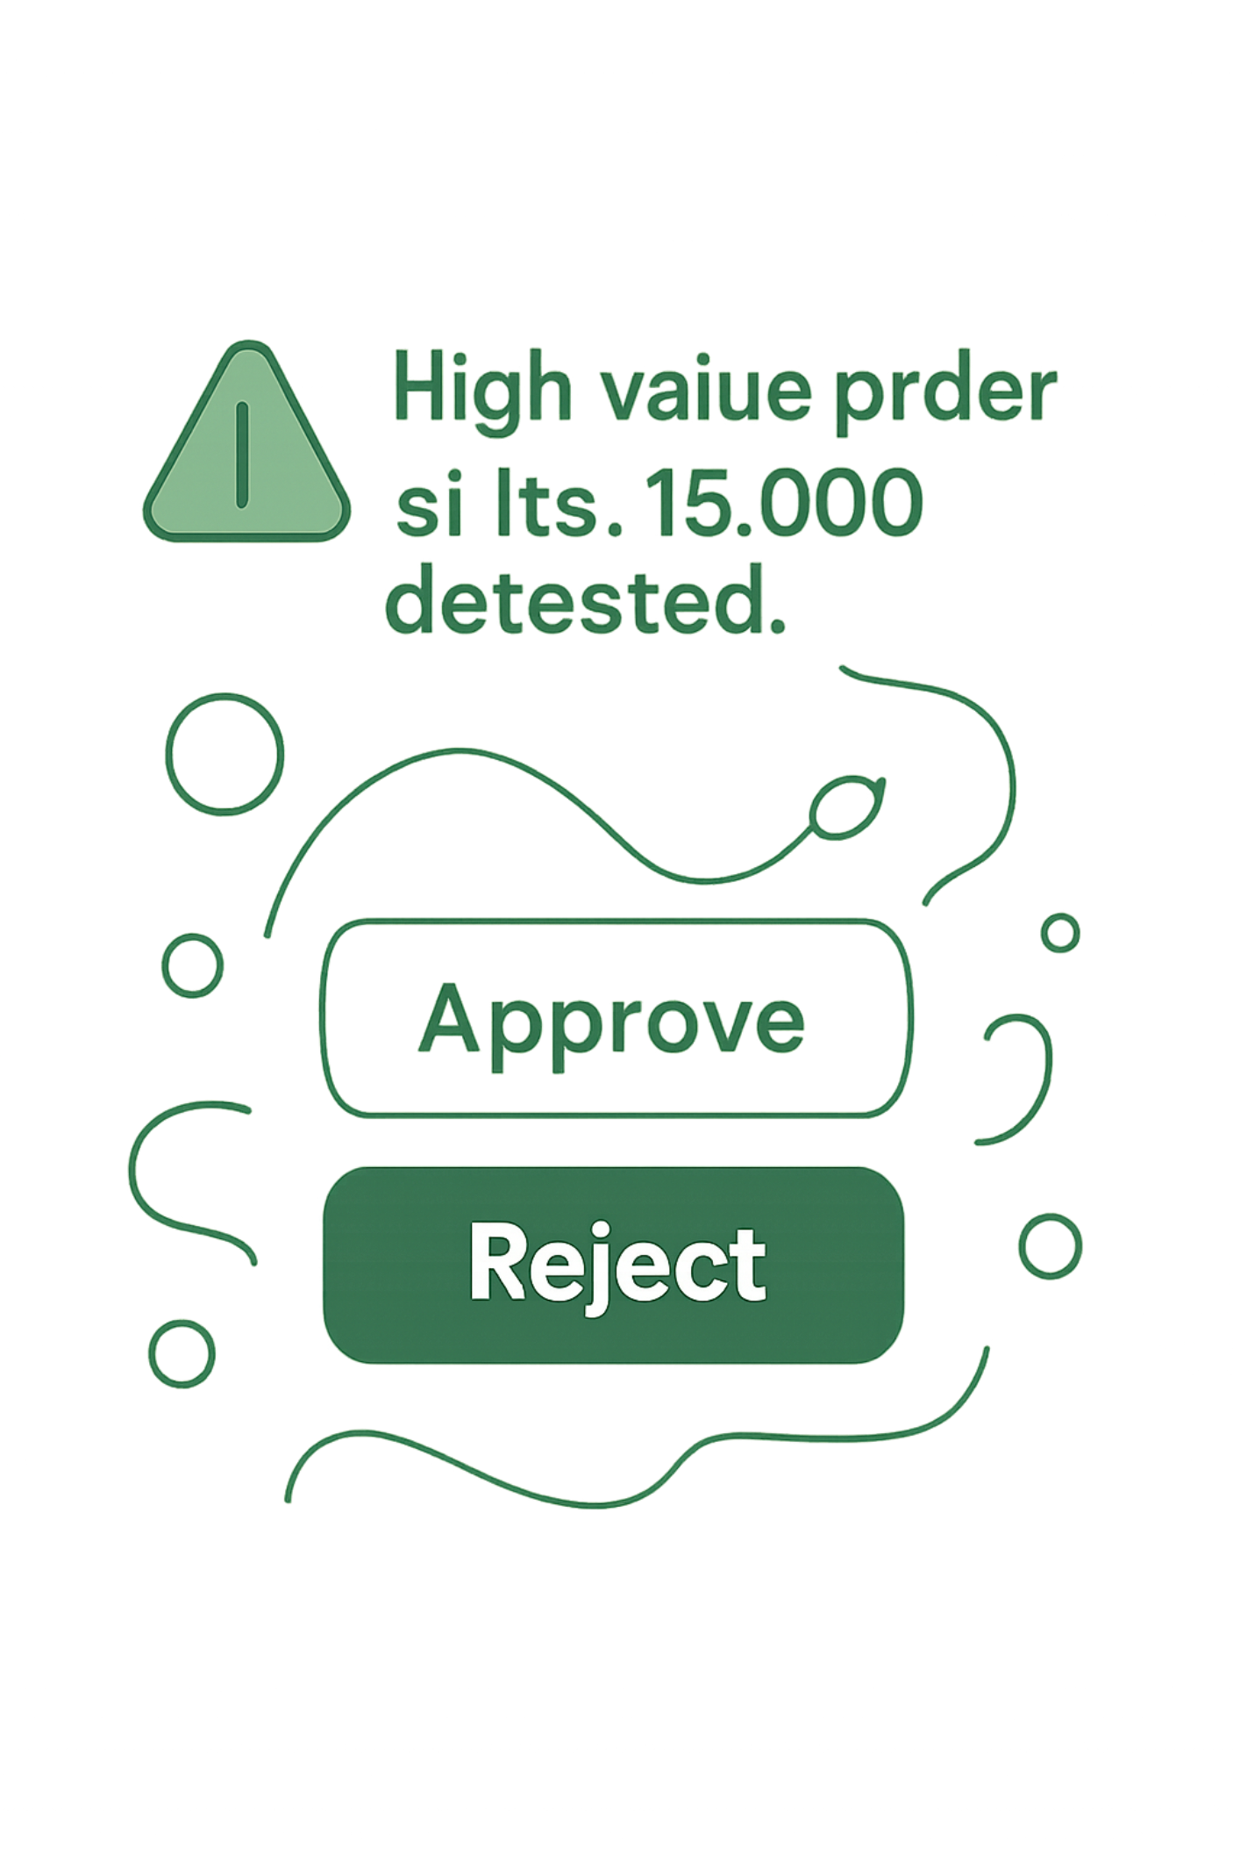
BUSINESS PROTECTION & SAFETY GUARDRAILS
Spoken Automations and Fraud Defense
Spoken Workflow Creator
Merchants set active store alerts simply by talking: "Jab doodh 5 carton se kam ho toh mujhe alert karo."
High-Value Fraud Guard
Orders exceeding customizable thresholds (e.g. Rs. 10,000) pause automatically, requiring explicit WhatsApp button approval.
Expiry Date Radar
Automated alerts notify merchants days before perishables expire, saving stock from going to waste.

Slide 17

PRODUCTION READY
Battle-Tested & Live in Production
VerbaTask is not a prototype. It is not a demo. It is a fully deployed, production-grade system with real infrastructure, real test coverage, and real merchant-facing endpoints running today.
61
Frontend
Backend API
verba-task.netlify.app — live merchant dashboard with real-time WebSocket sync.
verbatask-production.up.railway.app — production Railway deployment handling live WhatsApp webhook traffic.
Automated Tests
End-to-end test suite covering voice parsing, entity extraction, inventory sync, and receipt generation.
<1s
Payments Ready
End-to-End Latency
EasyPaisa, JazzCash, Meezan Bank, HBL — Pakistan's full digital payment stack integrated and mapped.
From voice note received to receipt delivered — sub-second on production infrastructure.
Ready to scale. Ready to partner. Ready to put a voice-first commerce OS in the hands of every dukaandar in Pakistan. — verbatask.business@gmail.com

Slide 18
Thank You / شکریہ
Digitizing Pakistan's Main Street, One Voice Note at a Time.
Try the Live System
Open for Q&A
Live Web Platform:
verba-task.netlify.app
Production API & WhatsApp Bot:
verbatask-production.up.railway.app
Official Inquiries & Partnerships:
verbatask.business@gmail.com
Team VerbaTask:
Muhammad Soban • Muhammad Ali • Talal Nasir • Muhammad Shiraz
The Closing Thought:
"Technology shouldn't require a classroom. If a merchant can speak, they can run their business on VerbaTask."
We are now ready for your questions and live demonstration.

